Slide 1

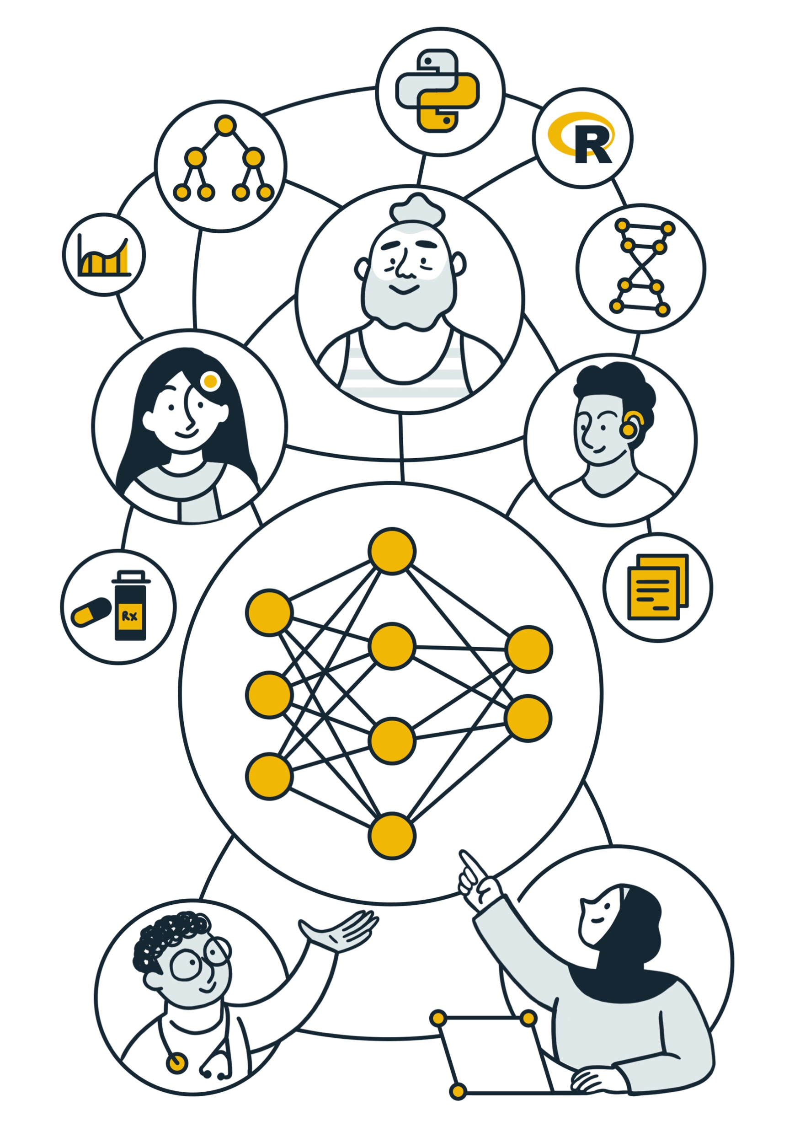




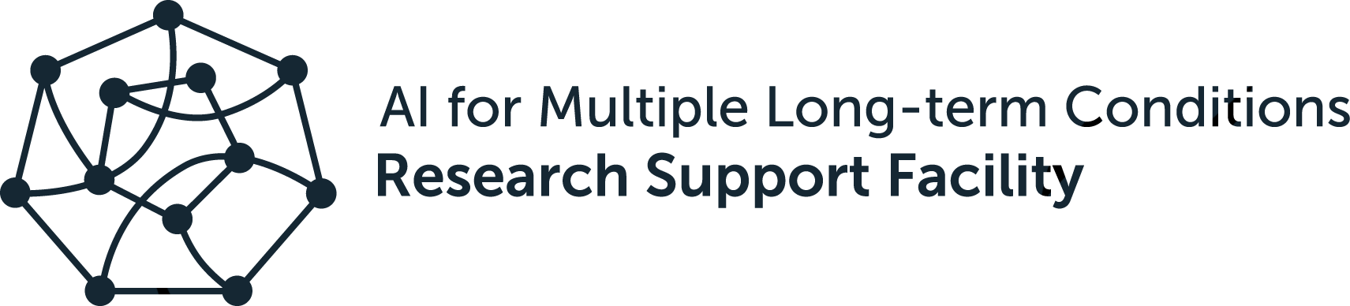
AI for Multiple Long-term Conditions
Research Support Facility

Slide 2
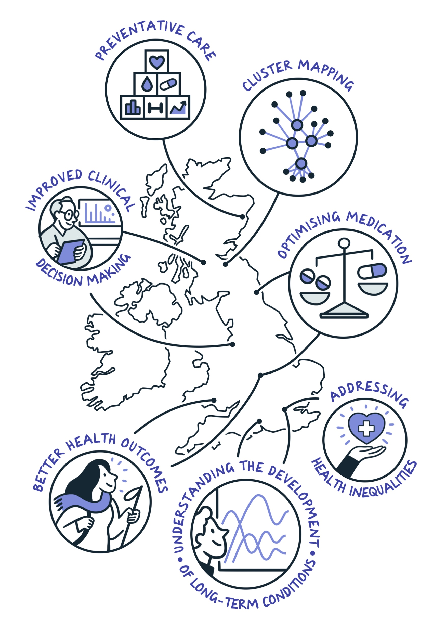
AI for Multiple Long-term Conditions (AIM).
NIHR AIM Programme
The AIM programme combines data science and AI methods with health care and social science expertise to identify new clusters of disease and understand how multiple long-term conditions develop over the life course.

Slide 3

AIM Research Consortia.
AIM CISC
AI MULTIPLY
Cluster AIM
DECODE
DynAIRx
MELD-B
OPTIMAL
Using AI to analyse and understand available information so as to establish the patterns of MLTC that are most common and affect people's lives most, with the goal of improving the quality and safety of care.
Characterising the dynamic relationships of MLTC and polypharmacy and inform healthcare pathways
Developing and validating population clusters to integrate health and social care using mixed methods.
Mapping the challenges and requirements for Data-driven, machinE learning-aided stratification and management of multiple long-term COnditions in adults with intellectual DisabilitiEs.
Developing new, easy-to-use AI and data viz tools that help GPs and pharmacists treat patients with MLTC.
Using AI-enhanced analyses of birth cohort data and electronic health records to identify life-course time points and targets for the prevention of early-onset, burdensome MLTC.
OPTIMising therapies, discovering therapeutic targets and AI-assisted clinical management for patients living with complex multiple long-term conditions.
University of Edinburgh
The Roslin Institute
NHS Lothian
University College London
Newcastle University
Queen Mary University London
University of Southampton
University of Oxford
University of Kent
University of Nottingham
University of Leicester
Leicestershire NHS Trust
Loughborough University
University of Leicester
De Montfort University
University of Liverpool
University of Leeds
University of Manchester
University of Glasgow
University of Southampton
University of Glasgow
Swansea University
Southampton City Council
University of Aberdeen
King’s College London
University of Birmingham
University of Manchester
University Hospitals Birmingham
NHS Greater Glasgow & Clyde
University of St. Andrews
MHRA

Slide 4
AIM Research Support Facility (RSF).
AIM Research Support Facility
The goal of the AIM RSF is to help embed best practices in data security and standards, reproducibility, and public and patient engagement across the AIM consortia, ensuring effective knowledge sharing.

Slide 5
Interconnected Research Themes.
Theme 2: Research-ready data
Theme 4: Public and Patient Involvement and Engagement
Theme 3: Community building and training
Theme 1: Reproducible, secure and interoperable infrastructure
Theme 5: Sustainability and Legacy

Slide 6



Theme 1: Reproducible, secure and interoperable infrastructure
Theme 3: Community building and training
Linking research collaborations across the UK within a trusted research environment for data, software and analysis sharing.
Examples: Horizon scan
Building connections between early career researchers across AIM and providing training and in computational skills to deliver reproducible research outputs.
Examples: training, events
Theme 2: Research-ready data
Experts in data curation work with AIM researchers to align datasets and standards.
Example: drug-coding lists, synthetic data

Slide 7

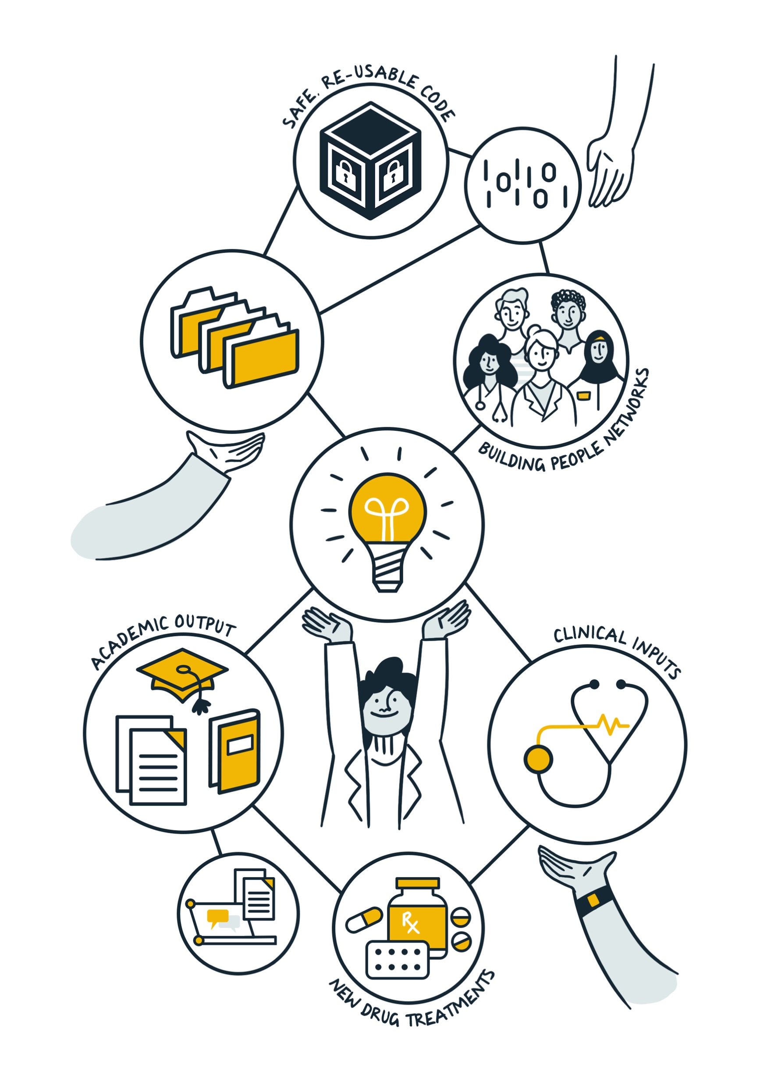
Theme 4: Public and patient involvement and engagement
Enhancing existing PPI networks to support those with lived experience of MLTC through events series
Examples: combined PPIE MLTC community
Theme 5: Sustainability and legacy
Embed outputs in existing communities, engage with policymakers to coordinate a long-term investment in MLTC research to impact as many people as possible.
Examples: engagement with CPRD on data access

Slide 8







ECR Lunchtime Sessions
Workshops
EVENTS
Seminar Series
Collaboration Cafes
Internal
External
PPIE Community Calls

